Slide 1
Chapter 4 - 1 pg 93 - 122 Gastrointestinal Drugs
Dr. Dipa Brahmbhatt VMD MpH, MS dbrahmbh@yahoo.com

Slide 2
OBJECTIVES
Basic physiology that controls the GI tract
Mechanism of emesis and antiemetics
GI motility and drugs that affect these
Mechanism of GI ulcers and anti-ulcer drugs
Drugs modification in the ruminant GI tract

Slide 3
Basic Anatomy and Physiology
The term gastrointestinal (GI) tract describes a long, muscular tube that begins at the mouth and ends at the anus.
Structures:
Oral cavity
Esophagus
Stomach: GASTRIC
Small intestine: Duodenum, Jejunum, Ileum: ENTERIC
Large intestine: Colon: COLONIC
Structures
monogastric animals with simple stomachs
ruminant animals with multichambered forestomachs
Unobstructed and regulated flow

Slide 4
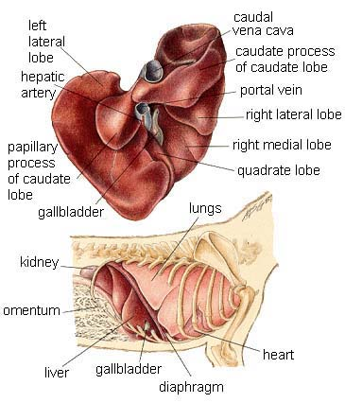
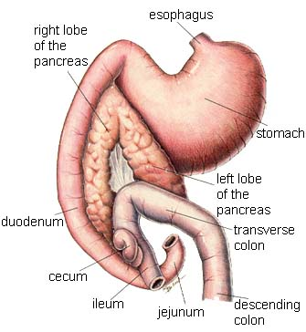
Basic Anatomy and Physiology
Accessory Organs: production/secretion of enzymes that aid in digestion
Liver
Gall bladder
Salivary gland
Pancreas

Slide 5
Monogastric: 3 major segments: stomach, intestines,
cecum and colon

Slide 6
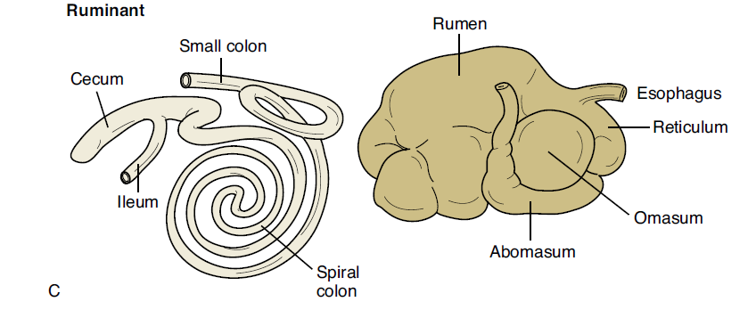
Forestomach: rumen, reticulum, omasum
True stomach: Abomasum
Abomasum and omasum: Digestion and absorption
Fermetentive digestion
Rumination: “chewing cud” by rumen and reticulum
Fermentation vat: bacteria and protozoa

Slide 7
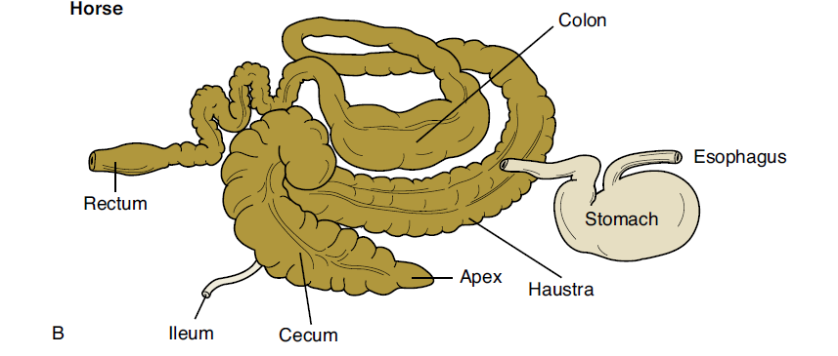
Non ruminant herbivores. Hind gut fermentators
Expanded colon and cecum: fermentative digestion
(may contribute to colic)

Slide 8
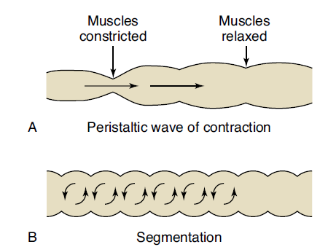
Function and Control of GI Tract
Peristalsis
Contraction of longitudinal and circular muscles in gut
Moves food
Stretch
receptors
increase
peristalsis
ANS
Segmentation
Periodic, repeated intestinal constrictions
Churns GI contents
ANS

Slide 9
Autonomic Nervous System
Sympathetic = “Fight or Flight”
Parasympathetic = homeostatic
Eat turkey and sleep it off = “Rest or Restore”
Neurotransmitter: Norepinephrine
Peripheral nerves: thoracic - lumbar
Cranial nerves (vagus) and peripheral nerves caudal portion of spinal cord
Neurotransmitter: Acetylcholine

Slide 10
Function and Control of GI Tract
One control mechanism of the GI tract is the autonomic nervous system
(parasympathetic and sympathetic branches)
Parasympathetic stimulation
Decrease HR
Miosis
Increases GI motility
Increases GI secretions (acidity) and digestion
Relaxes sphincters
Cholinergic drugs simulate these actions - CONSTIPATION
Anticholinergic drugs inhibit these actions (Glyco. And atropine) v/d, sedation

Slide 11
Function and Control of GI Tract
Sympathetic stimulation
Increased HR
Increased blood pressure
Decreases intestinal motility and secretions
Decreases GI secretions and digestion
Inhibits the action of sphincters
Sympathetic nerves simulate these actions

Slide 12
Function and Control of GI Tract
Biological Mediators
Prostaglandins: PgE and PgI
Increases intestinal mucus and fluid production
Increases intestinal motility
Increases blood flow where PG are active
Increases secretion of bicarbonate buffers
Decreases gastric HCL production
Anti-inflammatory drugs block PG hence protective function on stomach

Slide 13
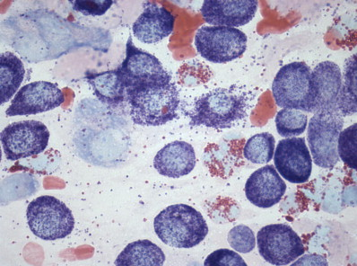
Function and Control of GI Tract
Biological Mediators
Histamine (from mast cells and basophils
during inflammation/ allergy) e.g. mast cells
H₁ Receptor (primary) >> Skin GI tract
H₂ Receptor >> parietal cells/ oxyntic cells >> HCL acid >> can lead to gastric/ duodenal ulcers
Parietal cells/ oxyntic cells have receptors for histamine (exacerbates gastrin and Ach effects),
Ach (PNS) and gastrin and all increase acidity in stomach
Gastrin: hormone
Released in stomach in response to protein/ PNS/ distention in stomach
Relax stomach and increase acidity in stomach

Slide 14
Gastrointestinal Disorders
Are the most common complains in vet. medicine
Underlying causes include:
Infectious sources
Bacterial endotoxins (Salmonella enteritis, Escheria coli, Staphylococcus spp.) >> secrete electrolytes (Na, Cl) >> profuse diarrhea
Dietary excess
Adverse drug effects
Systemic disease
Liver disease affects bile production and fat digestion

Slide 15
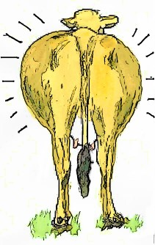
Gastrointestinal Disorders
These disorders result in clinical signs such as:
Diarrhea
Constipation
Vomiting
Bloat
Ulcer development
Pain
Colic - horses

Slide 16
Drugs Affecting the GI Tract
Antisialogues
Drugs that decrease salivary flow
Used to limit the flow of excess saliva, which often occurs secondary to anesthetic drug use
Examples include anticholinergics such as glycopyrrolate (safer for young and pregnant does not penetrate the CNS) and atropine
These drugs can also affect peristalsis because they are also used to treat vomiting, diarrhea, and excess gastric secretion
Decreases intestinal motility
Decreases GI secretions
Does not relax sphincters

Slide 17
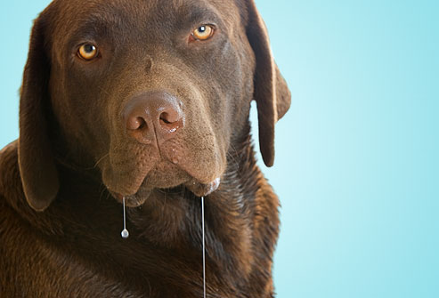

Slide 18
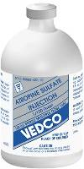
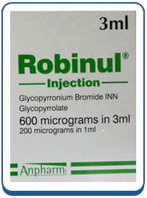
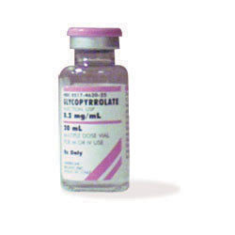
Glycopyrrolate (Robinul) and Atropine
Use Glycopyrrolate in
Pregnant animals it does not appreciably cross CNS or placenta
Atropine comes in
Two concentration: 0.5 mg/mL (injectable-SA)
and 2.0 mg/mL (injectable-LA)

Slide 19
Horses, rabbits and rats don’t vomit
Cattle don’t eject
Vomiting:
expulsion
of stomach (+/-
duodenal)
through
mouth
Often vomiting can
be controlled by NPO
and correcting
dehydration

Slide 20
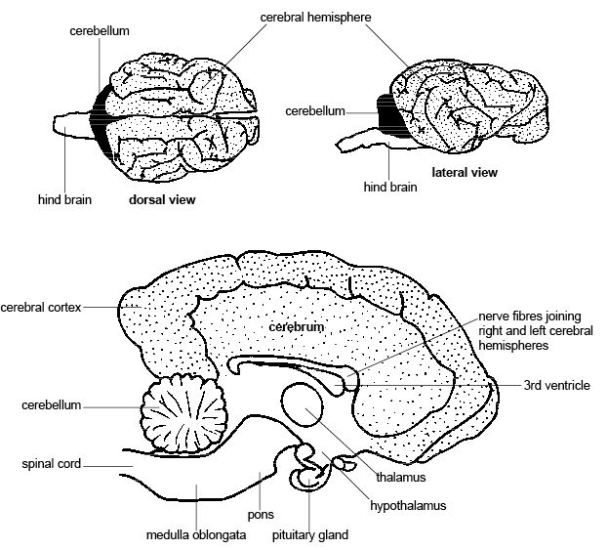
Medulla – brainstem: vomiting center/ emetic center: alpha adnergic receptors,
serotonin receptors. Cats very sensitive to this center:
more alpha adnergic receptors: xylazine, detomidine, medetomidine (dexdomitor)

Slide 21
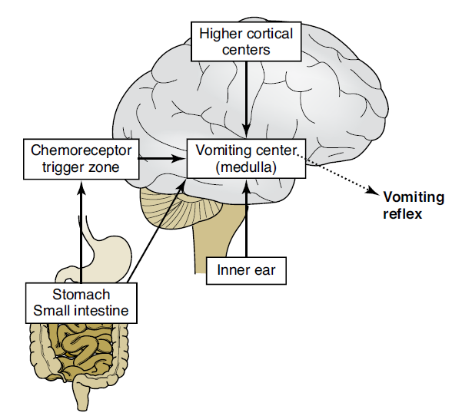
2. CRTZ (medulla)
Direct Stimulation
Senses toxins in
blood CSF fluid
Outside blood-brain
Barrier
Metabolic toxins – renal failure, ketones – DM, bacterial toxemia, digoxins, narcotic analgesics, poisons
Neurotranmitter
Dopamine: receptors more in dogs
Serotonin (5-HT receptor): cancer, parvovirus
H1 (histamine) receptor more in dogs
5. Higher center by emotional stimuli or intracranial trauma and swelling
Direct stimulation
of neurons in emetic center
alpha adnergic receptors
4. Stimulate of receptors
semicircular canals in the
inner ear – CN VIII (sensory)
3. Distention/ irritation of pharynx, stomach, duodenum, SI,
peritoneum (peritonitis), kidney, gall bladder, uterus: vagus nerve (PNS)

Slide 22
Emetics
Emetics
Drugs that induce vomiting
Used in the treatment of poisoning and drug overdose
Vomiting should not be induced if caustic substances have been ingested
Always check with poison control prior to inducing vomiting
Alkali, acidic, oxalate products , volatile liquids (more likely to be aspirated pulmonary edema): gasoline, light petroleum, most oils
Esophageal rupture/ perforation
No emesis: comatose, very depressed, lacking gag reflex, anesthesized, barbiturates, acepromazine, seizures e.g. strychine (pesticides, rat, mole control), bloat, gastric torsion, esophageal damage

Slide 23
Emetics
Activated charcoal is given if emesis is contraindicated (it absorbs many chemicals and drugs in the upper GI tract)
NB: Aspiration pneumonia; cuffed endotracheal tube
Timing:
Most liquid toxins >> absorbed in 2 hours
Solids toxins (rat poison) >> 4 hours
To vomit/ not to vomit: we may over do this!
Emetics
Centrally acting (CRTZ) emetics
Locally acting emetics (peripherally)

Slide 24
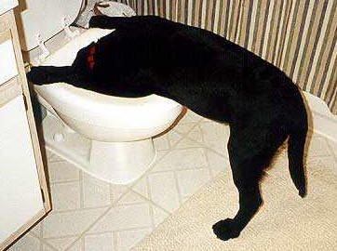
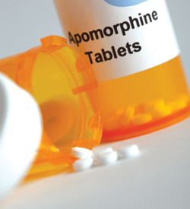
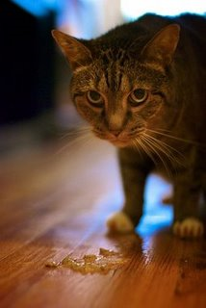
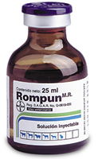
Emetics – Centrally Acting
Apomorphine
Opiod
* dopmaine receptors – CRTZ
IM/IV but most
Most available: tablet: high conc in blood to * CRTZ > conjunctiva sac (use this for “sniff” dogs)
SE: resp. depression reversed by naloxone (reversible antagonism)
Vomiting can be reversed by phenothiazine tranquilizers: acepromazine, droperidol
Xylazine (0.05mg/kg lower than sedation)
Alpha 2: CRTZ and emetic center
Reversed by Yohimbine

Slide 25
Emesis – Locally Acting
Locally/ Peripherally acting: irritate GI tract/ distend stomach/ * parasympathetic of emetic center
Ipecac syrup (pulled from market in 2004: bulimia …)
Home remedies
H2O2 (1/2 – 1 ml/ lb, max: 45 mL and no more than 2 doses in 15 min interval):
can result in gastritis
Fresh: looses potency in few months
Feed bread/ dog food: bulk for vomitus
Cats??
Warm concentrated salt solution: * pharynx. SE: dehydration/ salt toxicity (tremors/ seizures)
Powdered mustard and water
Gagging with finger > bite/ not effective

Slide 26
References
Romich, J.A. Pharmacology for Veterinary Technicians, 2nd edition. 2010.
Bill, R.L. Clinical Pharmacology and Therapeutics for the Veterinary Technician, 3rd edition. 2006.

